Slide 1

Exploring Access to Healthcare in the U.S. on an interactive dashboard.
Ghita Moummi
DATA606_Capstone
FALL2020

Slide 2

Agenda
Topic Overview & Recap
Model Comparison
Dashboard visualization on Tableau
Outcomes Summary
What can be done next?

Slide 3
Topic Overview & Recap
Visualize access to healthcare and distribution of disease in the U.S. to determine which states and which counties need the most intervention, and on what illnesses.
Next steps:
Use other Unsupervised ML algorithms to group our data
Compare the results of our ML algorithms
Build our Dashboard using the best clustering algorithm
Previously on “Exploring Access to Health Care in the US”:
Data cleaning and transformation
EDA- states with highest/lowest number of PCPs and states with highest/lowest percent of uninsured
Machine Learning: K-means clustering to group our data

Slide 4
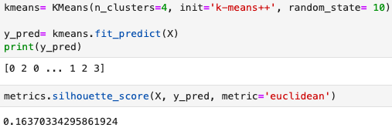
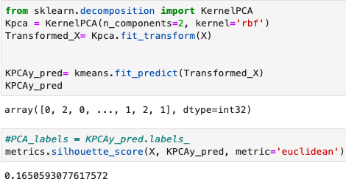
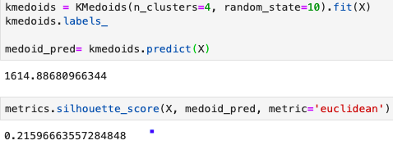


Model comparison
Models used:
K-means- uses k centroids (usually artificial points)
K-means with PCA; used prior to K-means for dimensionality reduction (31→2 dimensions- PC1 and PC2)
PAM (Partition Around Medoids)- uses medoids(always actual points in the dataset)
If the ground truth labels are not known, evaluation must be performed using the model itself.
A higher Silhouette Coefficient score relates to a model with better defined clusters.
Model Used | Silhouette Score
K-means | 0.164
K-means with PCA | 0.165
PAM | 0.21
Notes:
https://scikit-learn.org/stable/modules/clustering.html#clustering-performance-evaluation
https://www.askpython.com/python/examples/plot-k-means-clusters-python
https://rstudio-pubs-static.s3.amazonaws.com/455393_f20bacf1329a49dab40eb393308b33eb.html#:~:text=The%20main%20difference%20between%20K,actual%20points%20in%20the%20dataset.
Centroids are invented or existing points that represent the centers of the clusters.

Slide 5
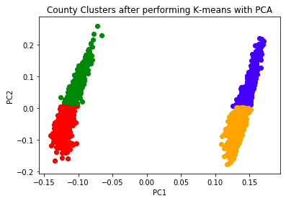
Model Comparison (cont.)
The radar chart for k-means and k-means with PCA was almost the same.
The radar chart for PAM was slightly different.
K-means Clustering after PCA
PAM- Partition Around Medoids

Slide 6
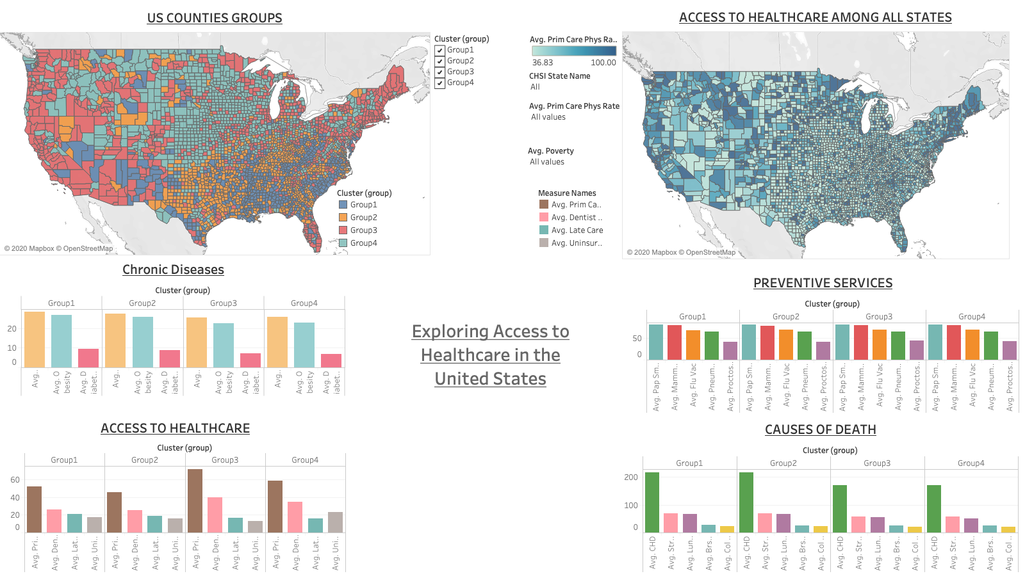
Dashboard visualization on Tableau
Notes:
See the Tableau workbook for the interactive dashboard or the PowerPoint for the static visualization on my Github page (link at the last page of presentation)

Slide 7

Outcomes Summary
PAM (Partition Around Medoids) worked best to group our dataset.
Counties that belong to Group 2 have the least number of Primary Care Physicians per 100,000 population, followed by counties in Group 1, Group 4, then Group 3.
Counties in Group 4 have the highest number of uninsured individuals .
Counties in Group 1 and 2 have the highest rate of chronic diseases.
Coronary Heart Disease (CHD)is the major killer in the US. It is a significantly higher cause of death in group 1 (216:100k) and group 2 (217:100k) than in group 3 (171:100k) and group 4 (171:100k)
Preventive services are not significantly different among our county groups.
Health officials and policy makers can make targeted decisions based on counties’ specific circumstances.
Notes:
Img. Source: http://www.supercoloring.com/paper-crafts/so-what-photo-booth-prop-message

Slide 8

What’s Next?
Health policy makers can use this dashboard to know which counties to focus on and on what conditions.
This dataset could be enhanced by plugging it to be live streamed or automatically updated every year. This would:
1. Improve our algorithm outcomes
2. Give us insight on how we are doing over the years.
3. Tell if our policies are making a difference whether positive or negative.
This project can be extended to other areas such as studying air quality .
Notes:
Img. Source: https://trishborgdorff.com/2020/11/07/now-what/

Slide 9
References
2.3. Clustering¶. (n.d.). Retrieved December 08, 2020, from https://scikit-learn.org/stable/modules/clustering.html
Chowdhury, P. P., Mawokomatanda, T., Fang Xu, Gamble, S., Flegel, D., Pierannunzi, C., Garvin, W., & Town, M. (2016). Surveillance for Certain Health Behaviors, Chronic Diseases, and Conditions, Access to Health Care, and Use of Preventive Health Services Among States and Selected Local Areas -- Behavioral Risk Factor Surveillance System, United States, 2012. MMWR Surveillance Summaries, 65(4), 1–139. https://doi-org.proxy-bc.researchport.umd.edu/10.15585/mmwr.ss6504a1
Gamble, S., Mawokomatanda, T., Fang Xu, Chowdhury, P. P., Pierannunzi, C., Flegel, D., Garvin, W., & Town, M. (2017). Surveillance for Certain Health Behaviors and Conditions Among States and Selected Local Areas -- Behavioral Risk Factor Surveillance System, United States, 2013 and 2014. MMWR Surveillance Summaries, 66(16), 1–139. https://doi-org.proxy-bc.researchport.umd.edu/10.15585/mmwr.ss6616a1
Health, S. (2020, July 02). Inequity Archives. Retrieved December 08, 2020, from https://skagitcounty.blog/tag/inequity/
Holtz, Y. (2017, October 09). #392 Use faceting for Radar chart. Retrieved December 08, 2020, from https://python-graph-gallery.com/392-use-faceting-for-radar-chart/
Kryńska, K. (2018, December 28). Using K-means and PAM clustering for Customer Segmentation. Retrieved December 08, 2020, from https://rstudio-pubs-static.s3.amazonaws.com/455393_f20bacf1329a49dab40eb393308b33eb.html#:~:text=The%20main%20difference%20between%20K,actual%20points%20in%20the%20dataset
Meyer, S. B., Luong, T. C., Mamerow, L., & Ward, P. R. (2013). Inequities in access to healthcare: analysis of national survey data across six Asia-Pacific countries. BMC Health Services Research, 13(1), 238–250. https://doi-org.proxy-bc.researchport.umd.edu/10.1186/1472-6963-13-238
Scamman, K., &amp; Scamman, K. (2017, October 20). Language Access and Healthcare Open Enrollment (Infographic). Retrieved December 08, 2020, from https://telelanguage.com/language-access-healthcare-open-enrollment-infographic/
So What Photo Booth Prop Message: Free Printable Papercraft Templates. (2019, May 07). Retrieved December 08, 2020, from http://www.supercoloring.com/paper-crafts/so-what-photo-booth-prop-message
Trishborgdorff, A. (2020, November 08). Now what? Retrieved December 08, 2020, from https://trishborgdorff.com/2020/11/07/now-what/
Unsplash. (n.d.). Beautiful Free Images &amp; Pictures. Retrieved December 08, 2020, from https://unsplash.com/
https://rstudio-pubs-static.s3.amazonaws.com/455393_f20bacf1329a49dab40eb393308b33eb.html#:~:text=The%20main%20difference%20between%20K,actual%20points%20in%20the%20dataset
Yumpu.com. (n.d.). Data Sources, Definitions, and Notes - Centers for Disease Control ... Retrieved December 08, 2020, from https://www.yumpu.com/en/document/read/36342808/data-sources-definitions-and-notes-centers-for-disease-control-

Slide 10
Thank you!
Questions?
gmoummi1@umbc.edu
https://github.com/gmoummi/Capstone_Project/tree/master

